Slide 1
Python Web Programming

Slide 2
Today’s Topic
Day 3: Python Programming – Part 2
Ø Nested Loop
Ø Conditional Loop

Slide 3
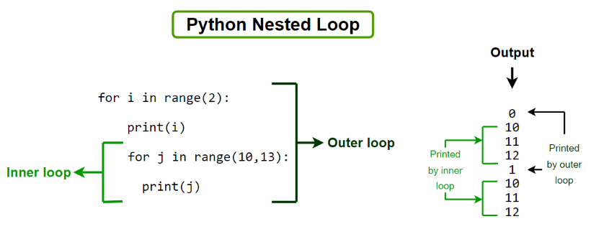
Nested Loop

Slide 4
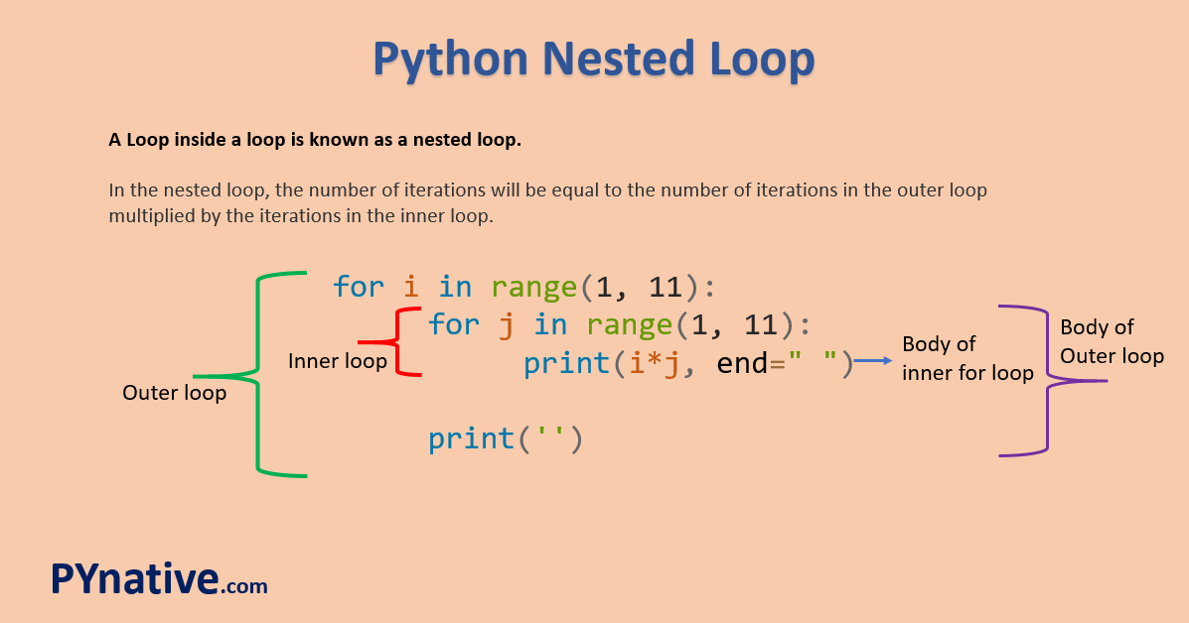

Slide 5
Class Work
*
* *
* * *
* * * *
* * * * *

Slide 6
Class Work solutions
rows = 5
# outer loop
for i in range(1, rows + 1):
# inner loop
for j in range(1, i + 1):
print("*", end=" ")
print('')
samples

Slide 7
Conditional Loop

Slide 8
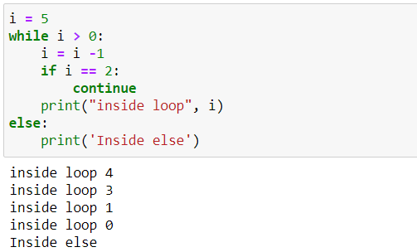
Class Work

Slide 9
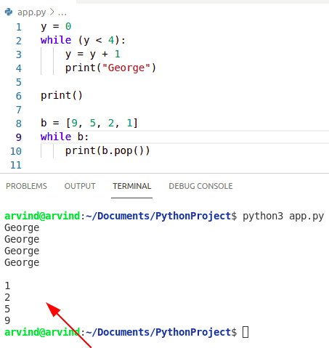
Class Work

Slide 10
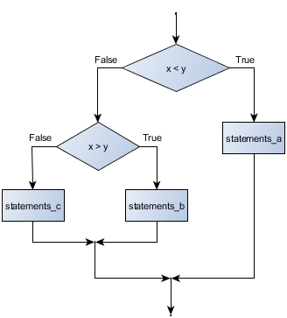
Nested Conditions
if x < y:
STATEMENTS_A
else:
if x > y:
STATEMENTS_B
else:
STATEMENTS_C

Slide 11
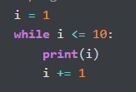
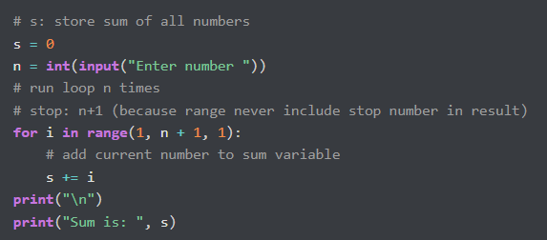
Homework solutions

Slide 12
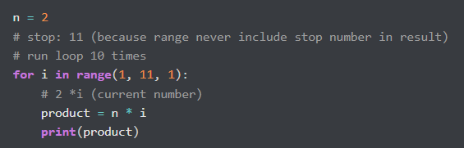
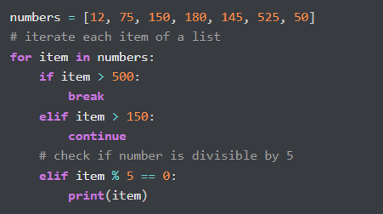
Homework solutions

Slide 13
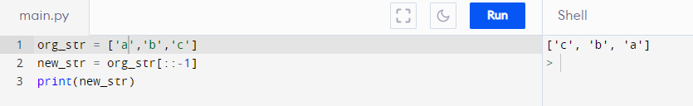
Homework solutions

